Slide 1







Mandatory Grants Roadshow
RULES FOR VIRTUAL ATTENDEES
Please turn
off Video
Please mute microphone
Questions will be answered as and when the need arises
If you have a question, type it in the chat box
RULES FOR
PHYSICAL ATTENDEES
Questions/inputs will be answered at the end of each presentation
Mute Phone

Slide 2
Welcome to TETA 2025/26 MANDATORY GRANTS
Roadshows
JANUARY 2025

Slide 3
Presentation Outline
TETA Background
Mandatory Grants Legal basis ( SDA/SDL and Grant regulation)
SIC Codes per Subsector
Intervention types
NQF Levels
MG Process
Composition of the training committee
Training Committee (TETA’s Perspective)
Training Committee minutes ( TETA Requirements)
Mandatory GRANTS – Common reasons for rejections
Mandatory Grants System Walkthrough
Key Information on the TETA website

Slide 4
Vision and Mission Statements and Core Values
INSPIRED VISIONARY LEADERSHIP THROUGH SKILLS DEVELOPMENT WITHIN THE TRANSPORT SECTOR
BUILDING A FORWARD THINKING AND GLOBALLY COMPETITIVE WORKFORCE BY FACILITATING SKILLS DEVELOPMENT PROGRAMMES THAT SUPPORT THE OUTCOMES OF THE NSDP AND RESPOND TO EMERGING SKILLS NEEDS OF THE TRANSPORT SECTOR
TRUST
RESPECT
RESPONSIBILITY
ACCOUNTABILITY
POSITIVE ATTITUDE
COMMINMENT
VALUES

Slide 5
Sub-sectors of the Transport Sector
AEROSPACE
TAXI
FORWARDING & CLEARING
8 CHAMBERS REPRESENTING EACH SUB-SECTOR
ROAD PASSENGER
FREIGHT HANDLING
ROAD FREIGHT
MARITIME
RAIL

Slide 6
National Reach by the Transport SETA
Freight Handling
Chamber
TETA has been able to service the entire country despite the offices being only in 5 provinces.
Namely Gauteng, Mpumalanga, Limpopo, Kwa-Zulu Natal and Western Cape

Slide 7


BACKGROUND
Standard Industrial Classification (SIC) Codes per sub-sector
FORWARDING & CLEARING
MARITIME
13100 – Ocean and Coastal Fishing
72000 – Water Transport
72111 – Coastal Shipping
72112 – Ocean Shipping
72200 – Inland Water Transport
71232 – Freight Forwarding and Clearing
AEROSPACE
FREIGHT HANDLING
73000 – Air Transport Including Aviation Maintenance Organisations in this field
73001 – Civil Aviation Including Aviation Maintenance Organisations in this field
74100 – Supporting and Auxiliary Activities Air Transport
74134 – Operations of Airports, Aerodromes & Air Navigation Facilities
RAIL
71300 – Transport via Pipelines Freight Handling
74132 – Salvaging of Distressed Vessels
74110 – Cargo Handling
74120 – Storage and Warehousing
71112 – Railway Commuter and Freight Services

Slide 8
BACKGROUND
Standard Industrial Classification (SIC) Codes per sub-sector
TAXI
71221 – Taxis
ROAD PASSENGER
ROAD FREIGHT
71200– Other Land and Transport
71201 – Road Transport
71211 – Urban, Sub-urban, and Inter-urban Bus and Coach Passenger Line
71212 - School Buses
94004 – Waste Management
74112 - Tow truck services
74121 - Tow truck services except where tow truck services are ancillary services to an enterprise where the core business is panel beating.
71230 – Freight Transport by Road

Slide 9
Mandatory Grants Legal Basis
The Sector Education Training Authority’s (SETAs) Grant Regulations makes provision for the submission of Annexure 2 by levy paying employers in order to claim mandatory funding from the SETAs.
A Mandatory Grant is a grant payable to levy paying companies upon submission of Annexure 2 by 30 April each year.
Levy paying companies employing 49 or less employees are not required to submit a PIVOTAL Plan and PIVOTAL report however are required to submit WSP and ATR each year.
In terms of section 6(3) of Skills Development Levies Act and Paragraph 4 (4) of the SETA Grant Regulations, the SETA shall pay back 20% of the total levies paid by the employer upon approval of the WSP and ATR.
Payments for Mandatory Grants shall be made quarterly and any Mandatory Grants not claimed in one year will be transferred to the discretionary grant fund reserve by 15th August each year as stipulated in paragraph 4(7) of the SETA Grant Regulations.

Slide 10
Mandatory Grants Legal Basis
SKILLS DEVELOPMENT LEVIES ACT of 1999
4. Are any employers exempt from paying the levy?
Yes. The exemptions are applicable if certain provisions are met. You will be able to apply for such exemptions, which you will find in the SDL 101 form, issued by the Commissioner of SARS. SARS will ultimately determine whether you qualify for an exemption or not
5. To whom are the levies payable?
Levies are payable to the South African Revenue Service, which acts as a collecting agency for the applicable SETA
6. When are levies payable?
The levy must be paid to SARS not later than SEVEN days after the end of the month in respect of which the levy is payable, under cover of a SDL 201 return form.
7. Is there any interest and penalty incurred for late or non-payment?
Yes, there is interest and penalty for late or nonpayment of skills Development Levies (SDL)

Slide 11
Mandatory Grants Legal Basis
SKILLS DEVELOPMENT LEVIES ACT of 1999
What is the aim of the skills development levy?
The levy grant scheme, legislated through the Skills Development Levies Act, 1999, serves to fund the skills development initiative in the country. The intention is to encourage a planned and structured approach to learning, and to increase employment prospects for work seekers. Participating fully in the scheme will allow you to benefit from incentives and to reap the benefits of a better skilled and more productive workforce
2. Who must Pay levy?
The levy is calculated as 1% of your wage bill, payable monthly. All employers who are registered with South African Revenue Services (SARS) for PAYE and have an annual payroll more than R500 000 must register with SARS to pay for the skills development levy.
3. How does an employer register for the levy?
Every employer who is liable to pay the levy must register with SARS by completing the registration form, Form SDL 101, which is available from all SARS offices.

Slide 12
Intervention Types
PIVOTAL Training: PIVOTAL is defined as Professional, Vocational, Technical and Academic Learning programmes that result in occupational qualifications or part qualifications on the National Qualifications Framework. The following form part of PIVOTAL training:
(NB: Companies employing 50 or more employees – submit PIVOTAL plan)
Workplace Based Learning Programmes
Apprenticeship
ARPL
Bursaries (TVET/ FET/ NCV/ HET)
Skills Programme
Occupational Qualifications

Slide 13
NQF Levels
Doctoral Degree
10
9
Masters Degree
Honours Degree/ Postgraduate Diploma
8
7
Bachelors Degree/ Advanced Diploma
Advanced Diploma Certificate
6
5
Higher Certificate
National Certificate
4
3
Intermediate Certificate
Elementary Certificate
2
1
General Certificate

Slide 14
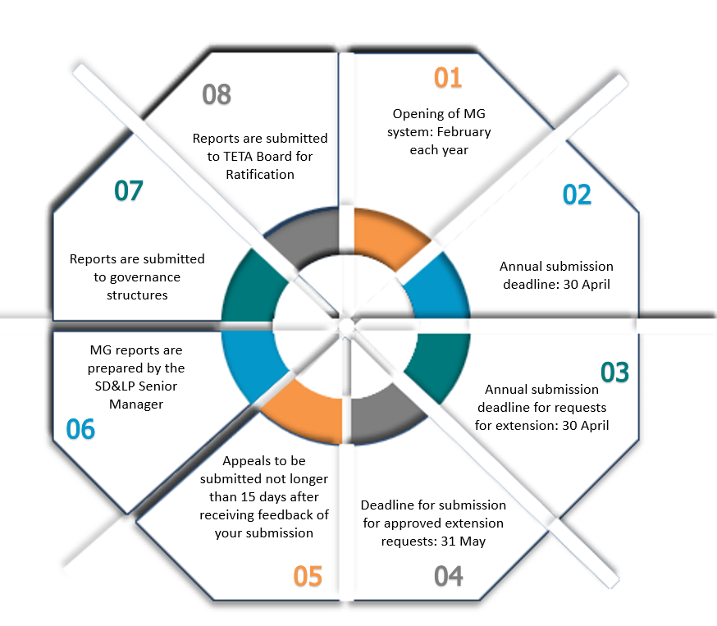
Mandatory Grants Process
Payments
June
September
December
March

Slide 15
Composition of the Training Committee
The Training Committee must consist of three groups: employer representatives, employee representatives, and union representatives (if applicable).
The number of employee and employer representatives may be equal; but there cannot be more employer representatives than employee representatives.
The SDF cannot be nominated as either an employee or an employer representative.
The SDF's role is to coordinate and advise, maintaining objectivity.

Slide 16
Composition of the Training Committee
The employee representative must be an employee of the organisation who is nominated or elected by the employees and must not be in a management position.
The employee representative’s responsibility is to discuss the skills development matters with employees within the organisation, and present employee skills development requirements and aspirations to the Training Committee for discussion and/or implementation.

Slide 17
Composition of the Training Committee
(CONTINUED)
Employee representatives must represent one of the Major OFO codes presented in the below unless there are no employees in the major OFO category:
Major Groups Version 2021
OFO Code
2021-1
2021-2
2021-3
Description
Managers
Workers
Plant And Machine Operators And Assemblers
Elementary Occupations
2021-8
2021-4
2021-5
2021-6
2021-7
Professionals
Technicians And Associate Professionals
Clerical Support Workers
Service And Sales Workers
Skilled Agricultural, Forestry, Fishery, Craft And Related Trades

Slide 18
TETA’S Training Committee Perspective
Medium and large companies are required to set up training committees
Training committees are to review performance against submission during the year.
Training committees are to endorse the submission made to TETA

Slide 19
Minutes Of The Training Committee Meeting – TETA Requirements
Companies employing more than 49 employees must submit proof of consultation (with recognised Union) in the form of minutes with the following requirements:
Minutes must be on the company letterhead
Minutes must be approved – signed and dated. Where it is not possible to approve before the submission of the WSP, the signed attendance register of the attendees must accompany the minutes- The minutes must indicate that the submission made to the SETA was discussed and approved.
Disclaimer: Small companies (employing 49 or less employees) are exempted from the above requirement however; they can have training committees should they wish.

Slide 20
Mandatory Grants Applications Common Reasons for Declines
General
Failure to report training implemented on the ATR
Medium and large companies who did not submit the following when applying for Mandatory Grants:
- ATRs, and WSPs,
- PIVOTAL report and PIVOTAL training plans
Mandatory grant appeals letter not accompanied by supporting documents as indicated on the reasons for the decline
Authorisation Page
Not uploaded on the system
Not fully completed and signed
The duly authorised official do not sign (mainly employer, employee representative and trade union representative where necessary)
Signatories do not form part of the training committee and are not captured on the training committee tab
The authorisation page provided is not clear
Employee Representative on training committee sign as employer representative (and vice versa)

Slide 21
Mandatory Grants Applications Common Reasons for Declines
Training Committee Meeting Minutes:
Not uploaded on the system;
Uploaded on the system but not on the company letterhead;
No evidence that the current year’s WSP/ATR was discussed;
No evidence of approval of the WSP/ATR by the Training Committee;
Minutes not signed by relevant signatories (e.g. Employer/Employer labour representative and trade union representative are compulsory for training committee only for large and medium companies)
Evidence of consultation must be provided where Trade-unions refuse to sign the authorization page

Slide 22
ATR Evidence Required
SMALL COMPANIES
20% of reported training
MEDIUM COMPANIES
5% of reported training
LARGE COMPANIES
5% of reported training
Evidence required for Training:
Preferred certificates, SOR or academic transcript.
If certificates are not available, Attendance Registers and Invoice and POP.

Slide 23

MG System Demonstration
INDICIUM

Slide 24
Critical information to note on the website
MG DOCUMENTATION
1
Version 2021 OFO Codes
Mandatory Grants Policy
2
3
SDF Manual
2025 SDF Presentations
4
5
6
Guideline for training committee minutes
SDF appointment letter template
8
Request for extension guideline/template
ATR evidence guidelines
7
Appeal letter template
9

Slide 25



Mandatory Grants Submission Timelines
27 January 2025
SDF Registration
  01 Feb - 30 April 2025
MG application period
MG Request for the extension period
31 May 2025
MG Extensions

Slide 26
Mandatory Grants Support During Submission
TETA staff will be available to provide guidance on the system during the time of submission;
System queries can be emailed to the relevant chamber
Dedicated team to assist with system-related matters and will be available until the 30th of April at 10:00 PM;
Chambers will be available for one-on-one meetings to assist with submission-related issues
Meetings/assistance will be provided telephonically via Zoom, teams or Google Meet

Slide 27
TETA Contact Details
Contact person, telephone, and email address | Chamber/Unit
Elias Phale +27 11 577 7021 / +27 71 418 5537 | EliasP@teta.org.za Motlatso Mohale +27 11 577 7084 / +27 83 314 2379 | Motlatso@teta.org.za Gaborone Lesito +27 11 577 7015 / +27 60 814 9192 | GaboroneL@teta.org.za | Aerospace
Tabane Mokgosinyana +27 11 577 7085 / +27 82 833 5223 | Tabane@teta.org.za Phamela Khosa +27 15 917 0006 / +27 72 782 8179 | Phamela.Khosa@teta.org.za Nomfundo Bhengu +27 11 577 7102 / +27 83 967 7876 | NomfundoB@teta.org.za Trevor Tjale +27 11 577 7085 / +27 625 8294 | TjaleT@teta.org.za | Forwarding and Clearing
Nomcebo Vezi +27 31 301 9614 / +27 73 224 9424 | NomceboV@teta.or.za Nokuthula Ngcobo +27 31 334 9883 / +27 74 387 8814 | NokuthulaN@teta.or.za Shantal Marajah +27 31 301 9614 / +27 83 629 7315 | Shantal@teta.org.za | Freight Handling
Samuel Motau +27 11 577 7053 / +27 76 742 6207 | SamuelM@teta.org.za Hulisani Thathaisa +27 11 577 7054 / +27 72 672 9174 | HulisaniT@teta.org.za Kate Setjie +27 11 577 7003 / +27 72 768 9394 | Kate@teta.org.za | Rail

Slide 28
TETA Contact Details
Contact person, telephone, and email address | Chamber/Unit
Khaya Ngubane +27 11 577 7079 / +27 82 932 9568 | Khaya.Ngubane@teta.org.za Tshitshi Mhlongo +27 11 577 7061 / +27 64 680 7928 | TshitshiM@teta.org.za Masana Hobyani +27 13 912 0005 / +27 71 342 8595 | MasanaH@teta.org.za Trevor Abrahams +27 11 577 7109 / +27 83 556 7713 | TrevorA@teta.org.za | Road Freight
Juanita Demas +27 11 577 7058 / +27 72 714 0656 | Juanitad@teta.org.za Simphiwe Ntuli +27 11 577 7057/ +27 60 462 6266 | Simphiwe@teta.org.za Trevor Abrahams +27 11 577 7109 / +27 83 556 7713 | TrevorA@teta.org.za | Road Passenger
Malcolm Alexander +27 21 819 9601 / +27 72 907 0754 | Malcolm@teta.org.za Sanele Mtambo +27 21 819 9602 / +27 78 548 0862 | SaneleM@teta.org.za Rana George +27 21 819 9605 / +27 79 321 4024 | Rana@teta.org.za Victor Muhlberg +27 21 819 9607 / +27 84 304 1067 | Victor@teta.org.za | Maritime
Ndumiso Nzama +27 11 577 7088 / +27 72 578 6351 | NdumisoN@teta.org.za Asanda Makaula +27 11 577 7115 / | AsandaM@teta.org.za Ramodise Tsolo +27 11 577 7105 / +27 78 456 0679 | Ramodise@teta.org.za | Taxi
Moeketsi Mahlakwana +27 11 577 7078 / +27 65 191 7424| MoeketsiM@teta.org.za Thato Mahlangu +27 11 577 7078 | Thato.M@teta.org.za Sipho Nxumalo +27 11 577 7080 / +27 61 549 6814 | Sipho@teta.org.za | Skills Development and Learning Programme
Samuel Motau +27 11 577 7053 / +27 76 742 6207 | SamuelM@teta.org.za Hulisani Thathaisa +27 11 577 7054 / +27 72 672 9174 | HulisaniT@teta.org.za Kate Setjie +27 11 577 7003 / +27 78 814 9192 | GaboroneL@teta.org.za | Rail
Simphiwe Ntuli +27 11 577 7057/ +27 61 402 9414 | Simphiwe@teta.org.za Trevor Abrahams +27 11 577 7109 / +27 83 556 7713 | TrevorA@teta.org.za | Road Passenger

Slide 29





Gauteng Head Office
344 Pretoria Avenue, Ferndale, Randburg, 2194
info@teta.org.za
011 577 7000

